Slide 1
Lecture 11: Testing of Feature Interactions
Gregory Gay
TDA 594/DIT 593 - December 7, 2020

Slide 2
Creating System-Level Tests
Identify an Independently Testable Function
Identify a function that can be tested in (relative) isolation.
Identify Choices
Identify controllable aspects of the input and environment that determine the outcome of the function.
Identify Representative Input Values
Identify types of values for each choice that lead to different function outcomes.
Generate Test Case Specifications
Combine values to form “recipes” for test cases.
Generate Test Cases
Replace representative values with concrete values.
Notes:
Last time, we discussed the process of creating System-level tests. As a reminder, this is a five stage process.
You need to figure out what the independently testable functionality of your system or subsystem is. What features or functions are surfaced by an interface and can be tested in isolation. What can we push and observe in the software?
For each of those features, we look at the inputs, configuration options, and execution environment. What can you control when you test this function that would influence the outcome of executing it? This includes both the actual input parameters - what you can pass to the functionality - and any other important aspects you can contorl and that might change the outcome, like database contents or the existence of a file.
For each of those choices, what types of input will trigger each possible outcome. What types of input should we try?
We then combine these representative values to form recipes for test cases, abstract test specifications that state the type of input we will provide. These can lead to many different concrete test cases when we
instantiate the specifications by replacing the abstract representative values with concrete values.

Slide 3

Test Specifications
May end up with thousands of test specifications.
Which do you turn into concrete test cases?
Identify the important interactions.
Notes:
Now, this process leaves you with all of these test specifications, abstract descriptions of test cases you could create. Each of those can lead to hundreds of concrete test cases. This is for ONE high-level function of your software. You clearly can’t try every one of those specifations. Which are important, then? Which should you take and instantiate as concrete system level test cases? This is something we will explore today. In short, (last)

Slide 4
Today’s Goals
Examine how feature interactions can create faults.
Examine how to select system tests to increase likelihood of detecting interaction faults.
Category-Partition Method
Combinatorial Interaction Testing

Slide 5
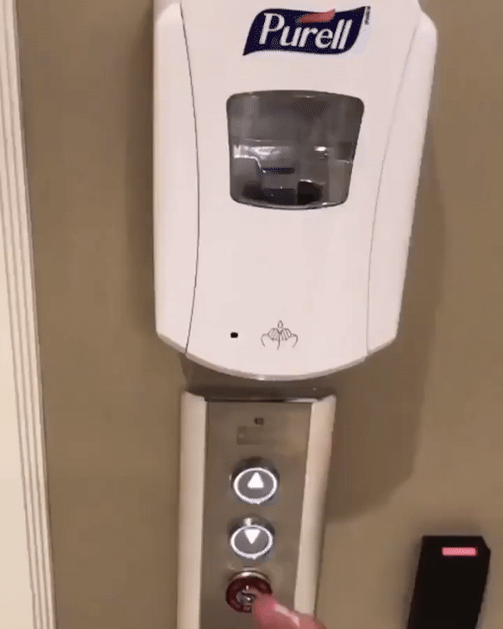
Feature Interactions
Features are expected to interact.
Usually this is planned!
Sometimes unplanned interactions break the system.
We should select tests that thoroughly test feature interactions.
Notes:
A key focus of this course has been on building customizable feature-rich systems, and we’ve talked about making features explicit in design and code, and separating and modularizing feature code. But a feature does not exist in a vacuum. Features interact in various ways, both in positive and intended ways, but also in critical and unplanned ways. Features are often expected to interact: to exchange information, to determine the behavior of other features, reuse the functionality of other features, and accomplish a task in cooperation. However, inadvertent interactions can cause unexpected and incorrect behaviors. Detecting and resolving unintended feature interactions is one of the key challenges of developing a complex system, and we want to design our test cases to examine critically important ferature interactions and have a high chance of detecting these interactions.

Slide 6

Feature Interactions
Feature interactions result from combining values of individual choices.
Inadvertent interactions cause unexpected behavior
(ex. incorrect output, timing)
Want to detect, manage, resolve inadvertent interactions.
Notes:
A function that works perfectly well in isolation may exhibit inadvertent behavior when combined with other functions to perform a higher-level task. The problem is that, when these features are developed independently, it is difficult to predict their mutual interactions when combined. Typically, the behavior of the complete product is not easily deducible from understanding the features in isolation—we have to identify and understand their interactions during system-level testing. An interaction between two or more subsystems or classes is an emergent behavior that cannot be easily deduced from the behaviors associated with the individual subsystems or classes involved. An inadvertent interaction occurs when one function of one subsystem influences the behavior of another function of a different subsystem in an unexpected way (for example, regarding the expected execution path through the code,unexpected program or data state, changes in timing, or other visible behavior). When we integrate lower-level components, their interactions need to be coordinated, for example, by ordering their execution, synchronizing data access, defining precedence rules for who gets to take an action when, and including missing behavior. Our problem is to detect, manage, and resolve these (inadvertent) interactions. At a high-level, these interactions are triggered by the choices we make when testing. That’s why it’s important to think about the input variables and environment - we want to make sure we identify different ways to manipulate the system in a thorough manner and really trigger the potential ways that interactions can go wrong.

Slide 7

Fire and Flood Control
FireControl activates sprinklers when fire detected.
FloodControl cuts water supply when water detected on floor.
Interaction means building burns down.
Notes:
As an example, consider fire and flood control. In a building-automation system, feature FireControl activates sprinklers when sensors detect a fire, and feature FloodControl cuts off water supply when water is detected on the floor. Individually, both features operate as desired, but they interact in inadvertent and critical ways: When fire is detected, feature FireControl activates sprinklers; sub- sequently, feature FloodControl detects standing water, and turns off the water main; as a consequence, the building burns down. Clearly, the interaction between FireControl and FloodControl is undesired, and inadvertent in the sense that it is hard to predict when planning and implementing the involved features independently. Only when the interaction is known, we can take corresponding steps to manage or resolve it, in this case, for example, by giving explicit priority to feature FireControl over feature FloodControl, controled by some coordination code.

Slide 8
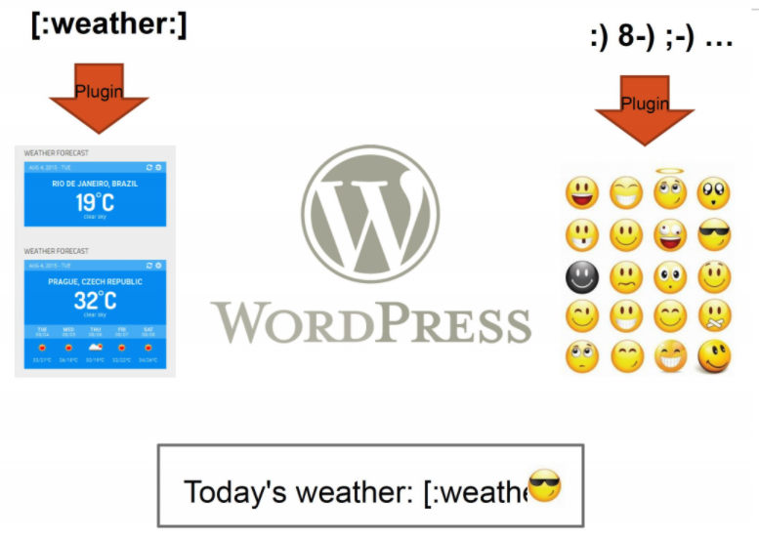
WordPress Plug-Ins
Weather and emoji plug-ins tested independently.
Their interaction results in unexpected behavior.
Notes:
Or, consider WordPress plug-ins. We have a plug-in that turns symbols into emoji. We also have a plugin that lets us insert a forecast widget into a post. Weather is activated using [:weather:]. However, :] is also an emoji. In isolation, each works really well. Each has been fully tested, and works as expected. When we combine them, we get unexpected behavior. The emoji plug-in activates first, turning :] into a smiling emoji. This then breaks the weather plug-in because it no longet sees the weather command. If the ordering was reversed, it would work just fine. However, these two plug-ins were developed independently and never tested together - why would they be? As a result, we get an unexpected interaction.

Slide 9


Feature Interactions
Notes:
I promised memes, right? These illustrate pretty succinctly how features can interact in unexpected ways even after you test each in isloation. On the left, a perfectly functional door lock on a perfectly functional sliding door. In isolation, great. Combined, that lock doesn’t do a bit of good. On the right, two windows. Each would work on their own, but in combination, they block each other. This illustrates why unit testing is crucially important, but so is system-level testing. Unit testing will completely miss how these features interact. These examples show the breadth of possible feature interactions. Some feature interactions are undesired and inadvertent in the sense that they are hard to predict when planning and implementing features in isolation. Other feature interactions are desired and planned in advance. In any case, features need to be coordinated (more or less explicitly), and that may require additional coordination code to make them work together. That also means feature interactions may harm feature modularity, because, besides the fact that each feature has its own code, there is additional code that does not belong to a single feature, but to a combination.

Slide 10
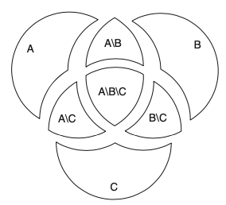
N-Way Interactions
Interactions between two features are called 2-way interactions.
If N features interact, this is an N-way interaction.
A, B, C have three 2-way interactions, one 3-way interaction.
Notes:
All examples so far illustrate interactions between pairs of features. The interaction between FireControl and FloodCon- trol is a 2-way interaction or first-order interaction. An interaction that occurs when three features are selected, but not for feature selections of pairs of these features, is called a 3-way interaction or second-order interaction. we can illustrate the possible interactions between the three features A, B, and C by overlapping circles. Three features can give rise to three 2-way interactions and one 3-way interactions (intersections between circles). This can extend into even higher numbers of features. If n features interact, but none of their strict subsets, this is called an n-way interaction.

Slide 11
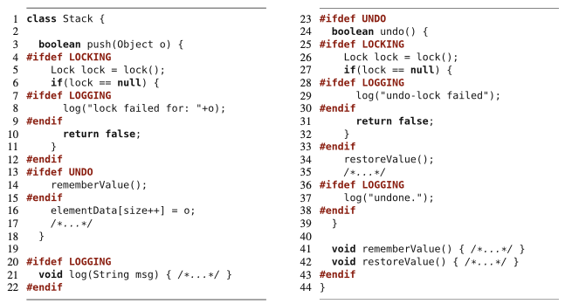
N-Way Interactions
Features: Locking, Logging, Undo.
Nested #ifdef indicate N-way interactions
2-way: 3
3-way: 1
Notes:
Higher-order interactions are hard to illustrate in small examples since they emerge from the complex combinations of features. Here, we have a small but dense code example of a Stack to illustrate a case where three features interact. In this example, variability is encoded using preprocessor directives. The code that coordinates the features of Stack is implemented in the form of nested preprocessor directives. We have three features Locking, Logging and Undo. There is code that belongs to the individual features, and code that belongs to combinations of features, which you can see in the nested #ifdef directives (the code is only included if multiple features are selected). In this code, we have 3 2-way interactions and 1 3-way interaction. Note particularly Line 29, which is only included if and only if all three features are selected. If this line caused a failure (for example, threw a null-pointer exception), the failure would occur only in products with all three features, but not in products that select only strict subsets of these features. Evidence indicates that (a) higher-order interactions occur in practice, but also that (b) higher-order interactions are rare compared to interactions between pairs of features; most failures are related to individual features or interactions between two features. This suggests concentrating testing effort on detecting 2-way feature interactions by analyzing mostly pairs of features, but it is worth keeping an eye on all levels.

Slide 12
Selecting Test Specifications
We want to select interesting specifications.
Category-Partition Method
Apply constraints to reduce the number of specifications.
Combinatorial Interaction Testing
Identify a subset that covers all interactions between pairs of choices.
Notes:
Now we are back to the problem of how to select interesting test specifications. We want the ones more likely to result in errors, and we want to ignore specifications that are not likely to tell us anything interesting. We’re going to talk about two approaches to control that set, and these two can even be combined. (go over)

Slide 13
Category-Partition Method
Notes:
So, how do we select the right feature interactions this when testing? There are two techniques we will cover, which are complementary. The first is called the category-partition method, and it is just a simple extension on the exact same process we talked about last class.

Slide 14
Category-Partition Method
Creates a set of test specifications.
Choices, representative values, and constraints.
Choices: What you can control when testing.
Representative Values: Logical options for each choice.
Constraints: Limit certain combinations of values.
Apply more constraints to further limit set.
Notes:
(title) is A method of generating test specifications from requirement specifications that is basically the same process we already talked about with the addition of a set of constraints used to limit the size of the set of test specifications. For an independently testable function, you identify (2). Choices and representative values are things we covered last time. Choices are what you control when testing - the types of values you can feed a parameter, the variants you choose at variation points in your feature model, and additional environmental factors that can influence the outcome of the function. Then, you identify representative values for each choice. Divide the input space up into logical partitions based on the outcomes they can trigger in the function. The new element here are the constraints. Three types of constraints - called if-constraints, error constraints, and single constraints, are used to control the number of test case specifications that you need to create concrete test cases for. once you have these categories, choices, and constraints, you can use them to estimate the number of test cases that you’ll need to generate, and (last point). This lets you determine the number of cases that you’ll need to create before spending human effort creating them. That’s a powerful concept - if you end up with too many test cases that need to be formed, you can apply more constraints until you get a reasonably sized test suite. This is obviously a better apporach than building a bunch of tests and then realizing that you’re out of time

Slide 15
Identify Choices
Examine parameters of function.
Direct input, environmental parameters (i.e., databases), and configuration options.
Identify characteristics of each parameter.
What aspects influence outcome? (the choices)
Choices are also called categories if you look up category-partition method.
Notes:
So, we start, as before, by (read title). So, just like before, you’ll (read 1). This includes not just the direct input parameters, but the environmental parameters like databases or hardware, and configurations options as well - what do we control, and what from that can affect the outcomes. What input, explicit and input, do we provide to that function? Then, we should think about what defines each parameter. (4) These are the choices in our test creation method, right? what are the factors that you control when testing that determine the outcome of a function. They may not reflect something that can be set in the code, but rather may be something test or outcome specific that you can control and that influence several of the variables in the code (last point). However, I am going to use the term choices to keep consistency with last class.

Slide 16
Example: Computer Configurations
Web shop that sells custom computers.
A configuration is a set of options for a model.
Some combinations are invalid (i.e., display port monitor with HDMI video output).
Function: checkConfiguration(model,configuration)
What are the parameters?
What are the choices to be made for each parameter?
Notes:
Let’s discuss an example. (1-2) Our independently testible function is checkConfiguration, which takes in a computer model and the set of options we chose and returns a yes or no - was it a valid configuration of that model or not?
What are the actual parameters? (discuss) Not just model and configuration. We also need some information on what defines a valid configuration - there might be a database of models and components that lists the options available. Even though that isn’t a direct input to the function, it’s something we need to consider as well. It’s required for the code to function and its contents impact execution. Ok, then, what can we and what do we actually need to control when we are testing this. What are our choices? We can turn to the requirements specifications or user stories or manuals - any other information we might have lying around that can tell us.

Slide 17
Example: Computer Configuration
Model: Identifies a product and determines constraints on available components. Identified by a model number. Characterized by a set of slots. Slots may be required (must be filled) or optional (may be left empty).
Configuration: Set of <slot, component> pairs. Must correspond to the required and optional slots of the model. Available components and a default for each slot are determined by the model. Slots may be empty (may be default for optional slots). Components can be compatible or incompatible with a model or with each other.
Notes:
read. So, this gives us more information. What defines a model - what choices do we make when we test? What can we control when we test? (discuss)
(id, num req slots, num optional slots)
think about how model influences the components - number of slots, what form are those slots, and are the selected components compatible with those slots?
(does the configuration correspond to the model (right number of required and optional slots)?, how many required slots have non-empty selections? how many optional slots have non-empty selections? what components have you selected for the required slots, what components have you selected for the optional slots? are they ok?)

Slide 18
Example: Configuration Choices
Parameter: Model
Model number
Number of required slots (must have a component)
Number of optional slots (component or empty)
Parameter: Configuration
Selected configuration valid for model?
Number [required/optional] slots with non-empty selections.
Selected components for [required/optional] slots OK?
Parameter: Product Database
Number of models in database
Number of components in database
Notes:
read
for now, keep product database simple. This looks like a lot, but it is important to look at all of the factors we control when we test that can lead to different outcomes

Slide 19

Identify Representative Values
Many values can be selected for each choice.
Partition each choice into types of values.
Consider all outcomes of function.
Consider logical ranges or groupings.
A test specification is a selection of values for all choices.
Concrete test case fills values for each abstract selection.
Notes:
Again, just like last time, we now want to form test specifications by coming up with representative values for each choice. (1) Especially if these correspond to input variables for the system, we may have a near-infinite number of poosible selections for each choice. we need to look at each choice and (read 2). consider the different outcomes of a function. Especially the error-handling cases, and make sure you try all of those variations out to make sure nothing bad sneaks through. Also (4), that you could break the variable down into that may lead to minor variations in the outcomes. Take, for instance, an integer and look at how different broad values of that integer can lead to different outcomes. Then, (last two)

Slide 20
Values for Each Choice
Parameter: Model
Choice: Model number
malformed
not in database
valid
Choice: Number of required slots
0
1
many
Choice: Number of optional slots
0
1
many
Parameter: Configuration
Choice: Configuration Matches Model
complete correspondence
omitted slots in configuration
extra slots in configuration
mismatched number of required and optional slots
Choice: Number of empty required slots that are empty
all required slots filled
some required slots empty
all required slots empty
Choice: Number of optional slots that are empty
all optional slots filled
some optional slots empty
all optional slots empty
Choice: Selected components for required slots
all valid
some kept at default
>= 1 incompatible with slot
>= 1 incompatible with another component
>= 1 not in database
Choice: Selected components for optional slots
all valid
some kept at default
>= 1 incompatible with slot
>= 1 incompatible with another component
>= 1 not in database
Parameter: Product Database
Choice: Number of models in database
0
1
many
Number of components in database
0
1
many
Notes:
(walk through)
NOT ALL POSSIBLE VALUES, think - it’s easy to capture the normal, everyday behavior, but think about what can go wrong and make sure you test that when you identify the representative values. Make sure you really capture the essence of the function you are testing. Think of all the ways it can break

Slide 21
Generate Test Case Specifications
Test specification = selection of values for choices.
Constraints limit number of specifications.
Eliminate impossible pairings.
Remove unnecessary options.
Choose a subset to turn into concrete tests.
1944 tests (all combinations)
678 Tests
40 Tests!
Notes:
-(1). So, at the base level, the number of possible test specifications is the cartesian product of the number of representative values for all choices. Now, the number of combinations of abstract test specifications grows exponentially as the number of choices and representative values for each grows. For a simple system with five choices and six values for each, the raw number of test specifications is 6^5, or 7776. Which, is an insane number of tests for a simple function. - That said, we still don’t need all of those. Many of those combinations may not even be possible, so that is where the idea of constraints comes into play. You want to eliminate any combinations that are impossible, identify constraints that can be used to remove unnecessary combinations, and from the remainder, choose a practical subset to test the system with then (last)

Slide 22
Values for Each Choice
Seven choices with three values, one with four values, two with five values.
3⁷ x 5² x 4 = 218700 test specifications
Not all combinations correspond to reasonable specifications.
Parameter: Model
Choice: Model number
malformed
not in database
valid
Choice: Number of required slots
0
1
many
Choice: Number of optional slots
0
1
many
Parameter: Configuration
Choice: Configuration Matches Model
complete correspondence
omitted slots in configuration
extra slots in configuration
mismatched number of required and optional slots
Choice: Number of empty required slots that are empty
all required slots filled
some required slots empty
all required slots empty
Choice: Number of optional slots that are empty
all optional slots filled
some optional slots empty
all optional slots empty
Choice: Selected components for required slots
all valid
some kept at default
>= 1 incompatible with slot
>= 1 incompatible with another component
>= 1 not in database
Choice: Selected components for optional slots
all valid
some kept at default
>= 1 incompatible with slot
>= 1 incompatible with another component
>= 1 not in database
Parameter: Product Database
Choice: Number of models in database
0
1
many
Number of components in database
0
1
many
Notes:
(go over)
For example, it isn’t reasonable to have a test with a valid model from the database where the database has no entries. So, we can eliminate some of these pairings.

Slide 23
Constraints Between Values
IF-CONSTRAINT
This value only needs to be used under certain conditions (if X is true, use value Y)
ERROR
Value causes error regardless of values of other choices.
SINGLE
Only a single test with this value is needed.
Corner cases that should give “good” outcome.
Notes:
There are three types of constraints that we can define to reduce the number of pairings.
-(1-2) for instance, you might choose a value for one choice only if a particular value is used for another choice.
-(3-4) so we don’t need every combination of values for all choices that include this particular value Just one test with this error-inducing value should be enough for us.
- (5-6) Single is similar to error, but more general purpose. A value is special or unusual in some way, but should still give us a “good” normal outcome. So we want totry it once just to be sure. However, we don’t need every combination of other values for other choices with this one value for this one choice. We just need one test that uses this particular value and we can move on.

Slide 24
Example - Substring
substr(string str, int index)
Choice: Str length Choice: index
length = 0 value < 0
length = 1 value = 0
length >= 2 value = 1
Choice: Str contents value > 1
contains letters and numbers
contains special characters
empty
property zeroLen, TRUE if length = 0
ERROR
if !zeroLen
if !zeroLen
SINGLE
if zeroLen
Notes:
Let’s take a simple example, a substr function. Takes in a string and an index and returns everything from the start of the string to that index. For each choice, we have some representative values (go over)
What are some of the constraints we can try applying? (discuss)
(click)- prop/if read
(click)- error
(click)- single - this one shouldn’t result in an error, but werid things could happen. We only really need to try it out once. It should execute and work,. So, let’s try it once

Slide 25
Example - Configuration Constraints
8 (error cases) + 6 (single cases) + (1⁷*2¹*3²) (RSMANY = true/OSMANY = true) + (1⁵*2³*3²) (false/true) + (1⁵*2³*3²) (true/false) + (1³*2⁵*3²) (false/false) = 464 test specifications
(after error + single): 8 (error cases) + 6 (single cases) + (1³*2³*3⁴) = 662
(after error): 8 (error cases) + (1¹*2³*3⁴*4²) = 10376
218700 test specifications
Parameter: Configuration
Choice: Configuration Matches Model
complete correspondence
omitted slots in configuration [error]
extra slots in configuration [error]
mismatched number of required and optional slots [error]
Choice: Number of empty required slots that are empty
all required slots filled
some required slots empty [if RSMANY]
all required slots empty
Choice: Number of optional slots that are empty
all optional slots filled
some optional slots empty [if OSMANY]
all optional slots empty
Choice: Selected components for required slots
all valid
some kept at default [single]
>= 1 incompatible with slot
>= 1 incompatible with another component
>= 1 not in database [error]
Choice: Selected components for optional slots
all valid
some kept at default [single]
>= 1 incompatible with slot
>= 1 incompatible with another component
>= 1 not in database [error]
Parameter: Model
Choice: Model number
malformed [error]
not in database
valid
Choice: Number of required slots
0 [single]
1
many [property RSMANY]
Choice: Number of optional slots
0 [single]
1
many [property OSMANY]
Parameter: Product Database
Choice: Number of models in database
0 [error]
1 [single]
many
Number of components in database
0 [error]
1 [single]
many
Notes:
(1^7 is seven choices with one value)
let’s walk through these We start with 218700 test specifications. Let’s work this down some by adding these constraints.
(click 1) So, the label error means that this is a value that only needs to be tried once when combined with the other non-error values of other choices. No matter the combination, if you have this value for this choice set, you get an error - so that right off the bat wipes out a lot of combinations. (walk through these). From 218700, we get down to 10376 test specifications. Huge impact right there. This still leaves a large number of test specifications to try, so let’s see if we can get this down further. Some combinations might not be erroneous, but might only be useful or valid in combination with certain other choices. For example, if the number of required components is 0 or 1, it makes no sense to check if some required slots are empty.
(click 2) Then, the single constraint acts like the error constraint. This is a situation that isn’t meant to be an error case, it should work, but it might be a boundary condition or a rare value where something odd could happen, so we try it once and don’t worry about it hte rest of the time. These single constraints take us from 10376 test specifications to 662! That’s much more resonable.
(clikc 3)So, that’s where properties and if-constraints come in. The property identifies a constraint. In this case, RSMANY indicates that there is more than one required slots. Similarly, we can mark properties on the number of optional slots. OSMANY means that we have more than one optional slot. Now, we look at situations where this matters. It matters for this “some required or optional slots” are empty. Using this value for this choice only makes sense if the property is true. Otherwiser, it is pointless. These properties remove invalid combinations. So, this reduces us from 662 specifications to 464 test specifications. This is still quite a few, but much better than 218000. where we started. We can add more constraints if we want. OR, our next technique, combinatorial interaction testing, is designed to choose an interesting subset from the remainder to cover the important choice interactions.

Slide 26
Activity - find service
https://bit.ly/31i2YcK
find(pattern,file)
Finds instances of a pattern in a file
find(“john”,myFile)
Finds all instances of john in the file
find(“john smith”,myFile)
Finds all instances of john smith in the file
find(““john” smith”,myFile)
Finds all instances of “john” smith in the file
Notes:
Let’s do an example together now.

Slide 27
Activity - find Service
https://bit.ly/31i2YcK
Parameters: pattern, file
What can we vary for each?
What can we control about the pattern? Or the file?
What values can we choose for each choice?
File name:
File exists with that name
File does not exist with that name
What constraints can we apply between choice values? (if, single, error)
Notes:
(go over) Give time to work on

Slide 28
Example - find Service
Pattern size:
Empty
single character
many characters
longer than any line in the file
Quoting:
pattern has no quotes
pattern has proper quotes
pattern has improper quotes (only one “)
Embedded spaces:
No spaces
One space
Several spaces
(2²*3³*4¹) = 108 test specifications
File name:
Existing file name
no file with this name
Number of occurrence of pattern in file:
None
exactly one
more than one
Pattern occurrences on any single line line:
One
more than one
Notes:
Go over
How many combinations - test specifications - 108 (two variables with two options, three with three, one with four. Niot too horrible, but still a lot for one function. Let’s constraint it.

Slide 29
ERROR and SINGLE Constraints
File name:
Existing file name
no file with this name
Number of occurrence of pattern in file:
None
exactly one
more than one
Pattern occurrences on target line:
One
more than one
Pattern size:
Empty
single character
many character
longer than any line in the file
Quoting:
pattern has no quotes
pattern has proper quotes
pattern has improper quotes (only one “)
Embedded spaces:
No spaces
One space
Several spaces
4 (error) + 2 (single) + (1²*2³*3¹) = 30
[error]
[error]
[error]
[single]
[error]
[single]
Notes:
Let’s narrow further. Can we apply any error constraints?
- go over. Now, anything we can try just once and leave out after?
- go over. How many tests now? 30! Much better shape, and down from our starting point of 108

Slide 30
IF Constraints
File name:
Existing file name
no file with this name
Number of occurrence of pattern in file:
None
exactly one
more than one
Pattern occurrences on target line:
One
more than one
Pattern size:
Empty
single character
many character
longer than any line in the file
Quoting:
pattern has no quotes
pattern has proper quotes
pattern has improper quotes (only one “)
Embedded spaces:
No spaces
One space
Several spaces
4 (error) + 2 (single) + (1³*2³) (quoted = true) + (1⁴*2²) (quoted = false) = 18
[error]
[error]
[error]
[single]
[property quoted]
[error]
[single]
[if quoted]
[if quoted]
Notes:
let’s add a constraint. (go over quoted) Maybe you had others. There are a lot of different things you could try here. Any questions?

Slide 31
Let’s take a break.
Notes:
10 minute break

Slide 32
Combinatorial Interaction Testing
Notes:
The second technique is called combinatorial interaction testing. It is complementary to the last approach. We take a pool of test specifications, possible filtered using category partition technique already, and the then try to identify a small pool of tests that cover all n-way (generally 2-way) feature interactions.

Slide 33
Limiting Num. of Test Specifications
Bandwidth Mode | Language | Fonts
Desktop Site | English | Standard
Mobile Site | French | Open-Source
Text Only | German | Minimal
 | Swedish
Advertising | Screen Size
No Advertising | Phone
Targeted Advertising | Tablet
General Advertising | Full Size
Minimal Advertising
Full set = 432 specifications
No natural IF, SINGLE, ERROR constraints for these features.
What is important to cover?
Notes:
However you get value classes for each choice, the next step in producing test case specifications is selecting combinations of values for those choices. A simple approach is to exhaustively enumerate all possible combinations of values, but as we saw the number of possible combinations explodes. Some methods, like the category-partition method, take exhaustive enumeration as a base approach to generating combinations, but allow the test designer to add constraints that limit growth in the number of combinations. This can be a reasonable approach when the constraints come naturally from the application domain, and eliminate many redundant combinations (like the “error” entries in the category-partition testing examples). It doesn’t work if you lack real constraints from the application domain,and the test designer is forced to add arbitrary constraints whose sole purpose is to reduce the number of combinations. How do you know you got it right? Consider the set of features that control the appearance of our web site, shown here on this slide. Exhaustive enumeration produces 432 combinations, which is too many for one feature. WE could hypothesize some constraints, such as observing that monochrome displays are limited mostly to hand-held devices, but radical reductions require adding several “single” and “property” constraints without any particular rationale. This is where category partition method can break down and why it is more of a starting point then the end point. So, what can we do with this?

Slide 34
Combinatorial Interaction Testing
Cover all k-way interactions (k < N).
Typically 2-way (pairwise) or 3-way.
Set of all combinations grows exponentially.
Set of pairwise combinations grows logarithmically.
(last slide) 432 combinations.
Possible to cover all pairs in 16 tests.
Notes:
When it is reasonable to expect some potential interaction between features, but covering all combinations is impractical, a reasonable alternative is to cover all k-way combinations for k < n, up to the limit of what we want to examine - typically pairs or triples (2-way or 3-way) feature interactions. How much does generating possible pairs of values save, compared to coming up with all combinations? We have already observed that the number of all combinations is the product of the number of values for each choice, and that this product grows exponentially with the number of choices. It turns out that the number of combinations needed to cover all possible pairs of values grows only logarithmically with the number of choices — an enormous savings in effort. (last two points)

Slide 35
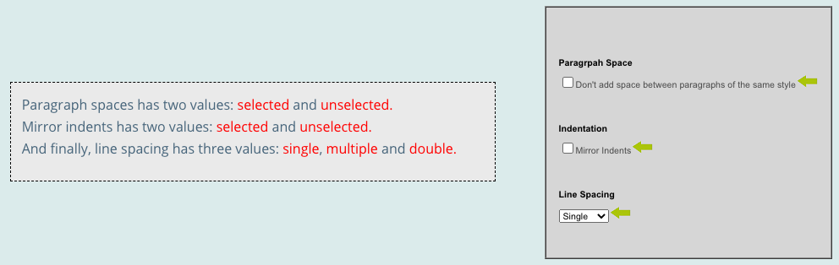
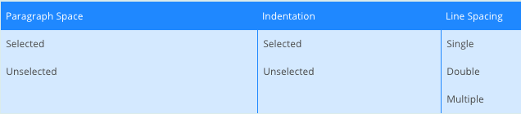
Example - Paragraph Effects
2 * 2 * 3 = 12 combinations
Notes:
Let’s look at an example of how we do this. Let’s say we can control how we display paragraphs in a document. We have three choices. (go over)
SO, 2 * 2 * 3 = 12 possible combinations. Not too bad, but we can shrink this.

Slide 36
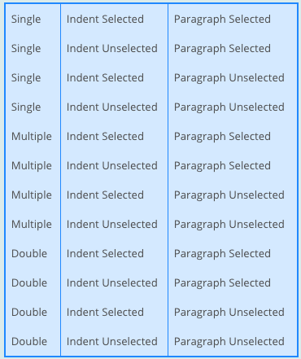
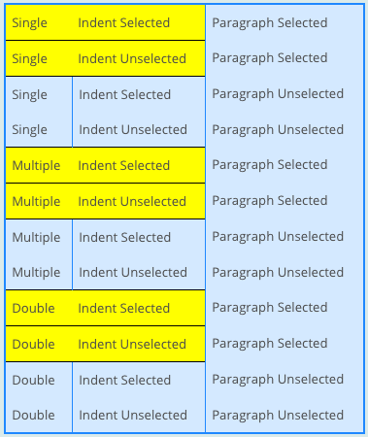
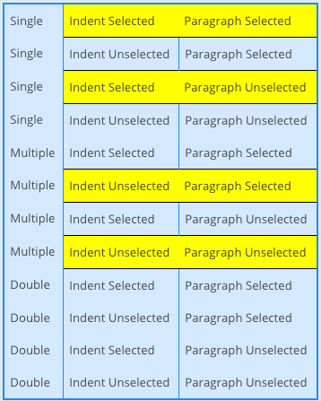
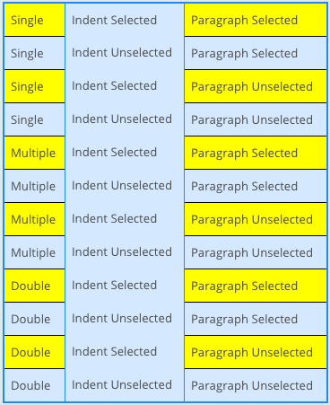
Example - Paragraph Effects
Notes:
Here is the enumerated list of all possible configurations. a large number of concrete test suites could be used to check each of these different configurations.Instead of checking all configurations we can look at only the 2-way (pairwise) combinations. This will reduce the total number of possible test suite configurations. (click) First we look at all the combinations of values between line spacing and indent selection. (go over) (click) Next we examine the combinations of values between indent selection and paragraph selection. (go over) (click) Finally we look at the combinations of values between line spacing and paragraph selection. (go over) You will notice then, that many of these overlap.

Slide 37
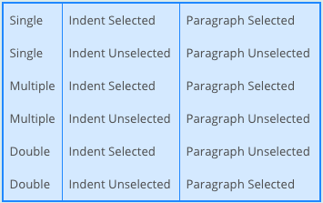
Example - Paragraph Effects
Goal of CIT is to produce covering array.
Set of configurations that covers all K-way combinations.
(2-way here).
Cover in 6 test specifications.
Notes:
By eliminating the configurations that repeat already tested pairwise combinations and some simple shuffling around you can create this array of 6 different configurations that covers all pairwise (2-way) combinations of input. This is what we call a covering array, a set of value selections for our choices that covers all - in this case - 2-way interactions. The goal of CIT is to create the smallest covering array we can. In this case, we can reduce from 12 down to 6 test specifications. In this small example it wasn't too difficult to create the pairwise covering array by hand, however when dealing with systems that thousands or even hundreds of configurations this is difficult. However, this not often something you do by hand and there are methods of generating small covering arrays that you can get, including tools from Microsoft, IBM, and others that attempt to generate covering arrays. We will also cover a simple approach next class that you can use to automate this process. However, today, let’s go through in more detail how you would do this yourself for small programs.

Slide 38
Example - Website Display
Bandwidth Mode
Desktop Site
Mobile Site
Text Only
Fonts
Standard
Open-Source
Minimal
Screen Size
Phone
Tablet
Full Size
Bandwidth Mode | Fonts
Desktop Site | Standard
Desktop Site | Open-Source
Desktop Site | Minimal
Mobile Site | Standard
Mobile Site | Open-Source
Mobile Site | Minimal
Text Only | Standard
Text Only | Open-Source
Text Only | Minimal
Screen Size
Phone
Tablet
Full Size
Tablet
Full Size
Phone
Full Size
Phone
Tablet
Cover all combinations for two variables.
Add a third, account for all combinations of pairs of values.
Each test specification can cover up to three pairs.
Notes:
Let’s take our website example again, and start with just three variables - Bandwidth mode, Screen size, and Fonts. Three variables, three values. In total, 27 test combinations. We can cover in fewer, though, as we just saw. (click) We can start with only the first two, bandwidth mode and fonts, the set of all pairs and the set of all combinations for that are the same, 3*3 = 9 combinations (go over). When we add the third parameter, screen size, generating all combinations requires combining each value class from screen size with every pair of bandwidth mode×fonts, a total of 27 combinations. However, if we are generating pairs of values from bandwidth mode, screen size, and fonts, we can add value classes of screen size to existing elements of bandwidth mode×font in a way that covers all the pairs of fonts×screen size and all the bandwidth mode×screensize without increasing the number of combinations at all. (click) The key is that each combination of three elements contains three pairs, and by careful selecting values we can make each combination cover up to three different pairs (go over) (see if there are questions)

Slide 39
Example - Website Display
Language | Advertising
English | No Advertising
English | Targeted Advertising
English | General Advertising
English | Minimal Advertising
French | No Advertising
French | Targeted Advertising
French | General Advertising
French | Minimal Advertising
German | No Advertising
German | Targeted Advertising
German | General Advertising
German | Minimal Advertising
Swedish | No Advertising
Swedish | Targeted Advertising
Swedish | General Advertising
Swedish | Minimal Advertising
Bandwidth Mode
Desktop Site
Mobile Site
Text Only
-
-
Desktop Site
Mobile Site
Text Only
Text Only
-
Desktop Site
Mobile Site
Mobile Site
Text Only
-
Desktop Site
Fonts
Standard
Open-Source
Minimal
Minimal
-
Minimal
Standard
Open-Source
Minimal
-
Open-Source
Standard
Open-Source
Standard
-
Minimal
Screen Size
Phone
Tablet
Full Size
Phone
-
Full Size
Tablet
Phone
Tablet
-
Phone
Full Size
Full Size
Phone
-
Tablet
Bandwidth Mode | Language | Fonts
Desktop Site | English | Standard
Mobile Site | French | Open-Source
Text Only | German | Minimal
 | Swedish
Advertising | Screen Size
No Advertising | Phone
Targeted Advertising | Tablet
General Advertising | Full Size
Minimal Advertising
Mobile Site
Notes:
Let’s extend this now to the full set. Five choices. Two with four options, and three with three = 432 combinations, but we can do it in less. Again, start with two variables. Start with the ones with the most options. In this case, we have two with four choices (click) So, 16 combinations (4x4). (go over) Now, we want to add a third. The rest all have three values, so add any of those. We will add bandwidth mode (click) Here, we want to again try to match all combinations with the previous two. (go over). Now, there are fewer values for this variable, so you’ll notice some dashes. These are cases where we don’t really care what value we pick. We might need to fill in some of these later on, but for now, they could be any combination. (click) Now, we bring in the fourth, fonts. (click) Now, here we need to go back and fill in a “don’t care” for bandwidth mode to get a “mobile” interaction with minimal. Finally, we add that fifth, screen size (click) Here, we don’t need to set any more don’t care values to get all combinations in. So, we can do this in 16 tests. Way better than 432! We might still miss issues with higher-order feature interactions, but all 2-way interactions - which are the most common source of problems - will be caught this way.

Slide 40
Constraints
Remove all ERROR/SINGLE cases before CIT.
Error output, one-time corner cases
Constraints on value combinations specified:
OMIT(Text-Only, *, *, Full Size, *)
OMIT(*, *, *, Full Size, Minimal)
Further reduces number of test specifications.
Notes:
So far, we’ve assumed that all combinations are legal. In many cases not all values for all choices may be allowed. In fact, before applying CIT, we should remove all ERROR and SINGLE cases that we would have noted in category-partition method. Then, we can state constraints on combinations the rest of the values For example, the specification of the Web site display may indicate that
text-only displays are limited to phone and table screen sizes. We can restrict the set of legal combinations of value classes by adding suitable constraints. Constraints can be expressed as tuples with wild-cards that match any possible value class. The patterns describe combinations that should be omitted from combinations. So, for our previous example, we might specify constraints this way: (examples) This (last point), but can make it complicated to come up with the covering array as you need to be careful to obey all constraints.

Slide 41
CIT Tools
Pairwise Independent Combinatorial Testing (Microsoft): https://github.com/microsoft/pict
Automated Combinatorial Testing for Software (NIST): https://csrc.nist.gov/projects/automated-combinatorial-testing-for-software
.. Many more: http://www.pairwise.org/tools.asp
Notes:
and like I said, next class, we’ll also talk about how you could program your own CIT tool.

Slide 42
Activity - Browser Configuration
https://bit.ly/3G2I00a
Allow Content to Load | Notify About Pop-Ups | Allow Cookies | Warn About Add-Ons | Warn About Attack Sites | Warn About Forgeries
Allow | Yes | Allow | Yes | Yes | Yes
Restrict | No | Restrict | No | No | No
Block |  | Block
Full set of test specifications = 144
Create set covering all pairwise value combinations.
Hint: Start with two variables with most values. Add one variable at a time.
Notes:
let’s do one more example interactively. You are designing system-level tests for a web browser with multiple configuration options. You have extracted the following choices, with the following representative values for each: (go over) The full set of possible test specifications contains 144 options. Create a covering array of specifications that covers all pairwise value combinations in fewer test specifications. (hint: start with two variables with the most values and add additional variables one at a time)

Slide 43
Activity Solution
Allow Content | Allow Cookies
Allow | Allow
Allow | Restrict
Allow | Block
Restrict | Allow
Restrict | Restrict
Restrict | Block
Block | Allow
Block | Restrict
Block | Block
Add-Ons
Yes
No
-
No
-
Yes
-
Yes
No
Forgeries
Yes
No
Yes
No
Yes
No
Yes
-
No
Pop-Ups
Yes
No
-
-
Yes
No
No
-
Yes
Attacks
Yes
Yes
No
No
-
Yes
-
No
Yes
No
No
Yes
Notes:
start with the two variables with three values (click) now add any of the two value ones , pop-ups (go over) (click) add-ons(click) attachs - need to fill in some of those values (click) forgeries, can do without filling anything (ask questions?)
From 144 to 9 test cases. Yours might look a little different

Slide 44
We Have Learned
Process for deriving system-level tests often results in too many test specifications.
Two methods that identify important interactions:
Category-Partition Method: Use constraints to eliminate unnecessary tests.
Combinatorial Interaction Testing: Identify important pairs of input values.
Notes:
(read)

Slide 45
Next Time
Automated test case generation using search/optimization.
Assignment 4 - Due Sunday
Modularity/Design Patterns
Questions?

